Slide 1
Geotechnical Aspects of the Moisture Level System
Presentation for the Structural Engineers Association of Arizona
January 17, 2017
J. David Deatherage, PE, President
Copper State Engineering
&
Bob Brown, President
Arizona Foundation Solutions

Slide 2
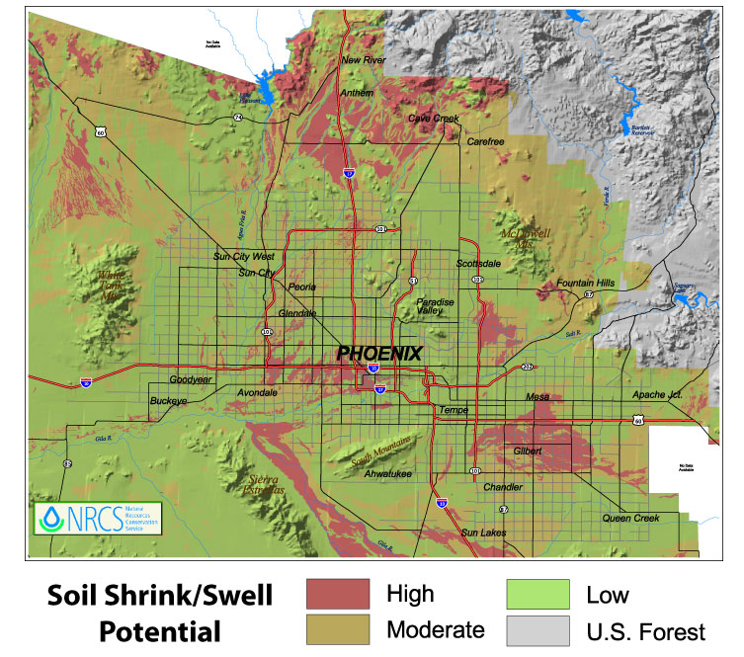
NRCS Greater Phoenix Area

Slide 3
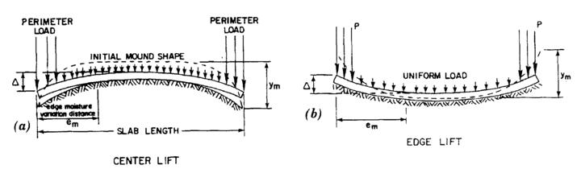
Expansive Clay Soil Movements Under Slabs due to Soil Moisture Increase

Slide 4
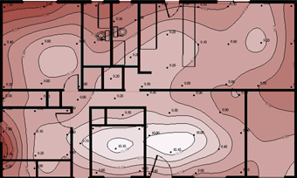
Floor Level Manometer Survey
0.1 inch +/- repeatability, valuable to monitor slab movements when repeated – yellow arrow is low elevation slab area, green area is high elevation slab area – correct for varying flooring thickness

Slide 5
Common ways to eliminate the source of increasing soil moisture under a home include improving drainage away from the perimeter of the home and eliminating ponding. Rain gutters and piped area drains can be used where positive drainage is difficult. Remove or relocate high water use plants and trees and automatic watering systems. Check pressure water lines, pools and waste water lines for leakage and promptly repair any leaks found. Collect air conditioning condensate drainage and discharge away from the perimeter of the home.

Slide 6
Once the commonly applied moisture control mitigation methods have been completed, you can consider removing moisture from the clays under a home using the Arizona Foundation Solutions Moisture Level System. The goal is to eliminate additional soil heave. In some cases you may also be able to carefully reduce a portion of the original heave.

Slide 7
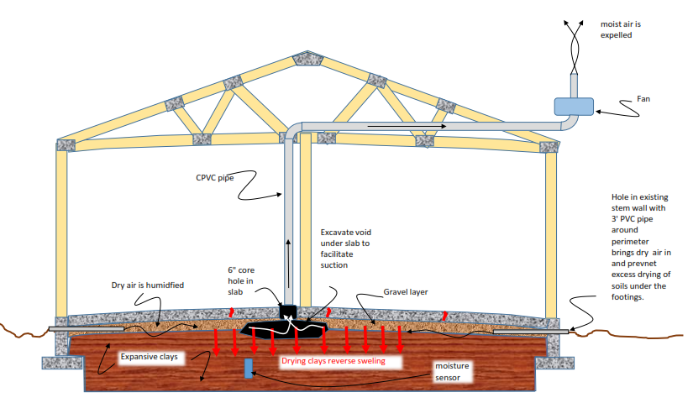
Arizona Foundation Solutions
Moisture Level System

Slide 8
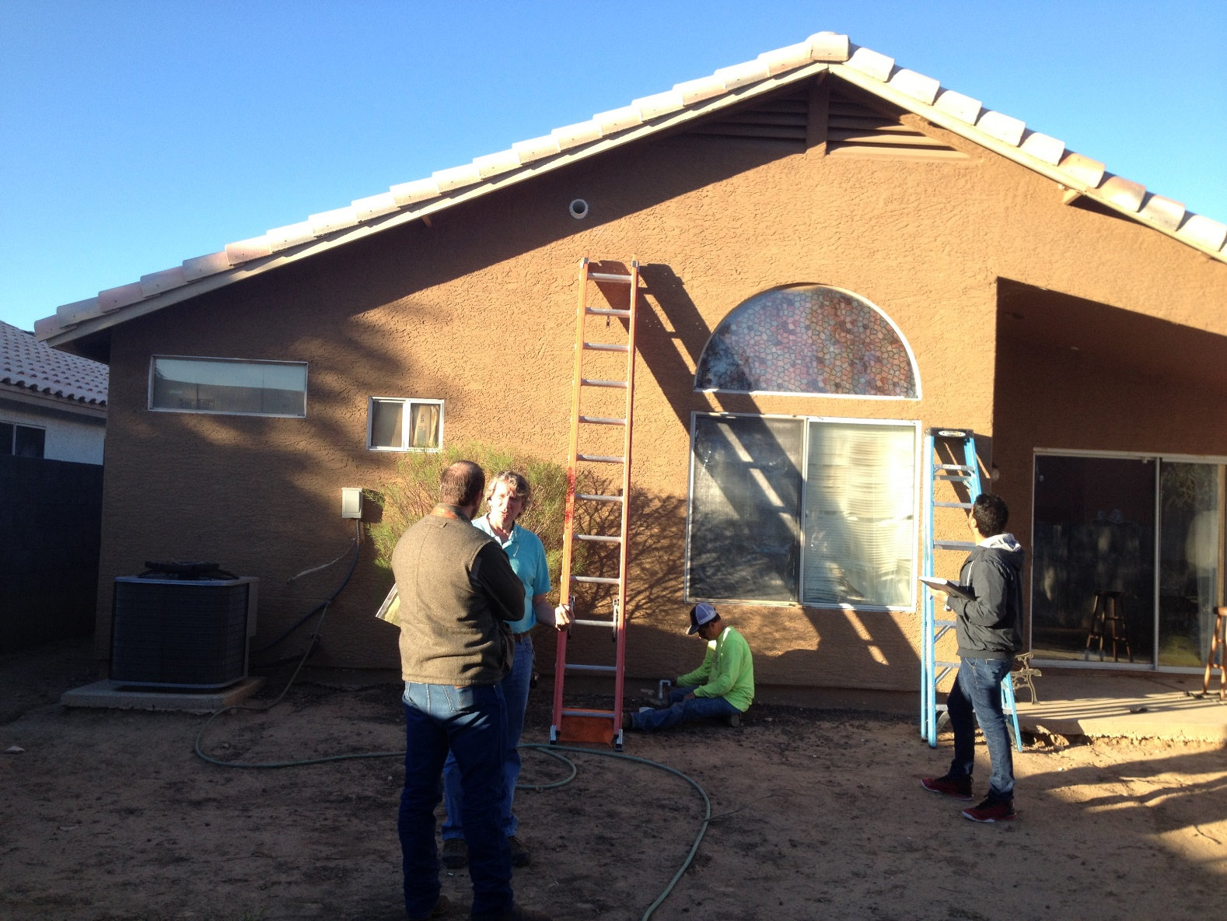
Moisture Level System Fan Pipe Outlet and Outside Air Inlet

Slide 9
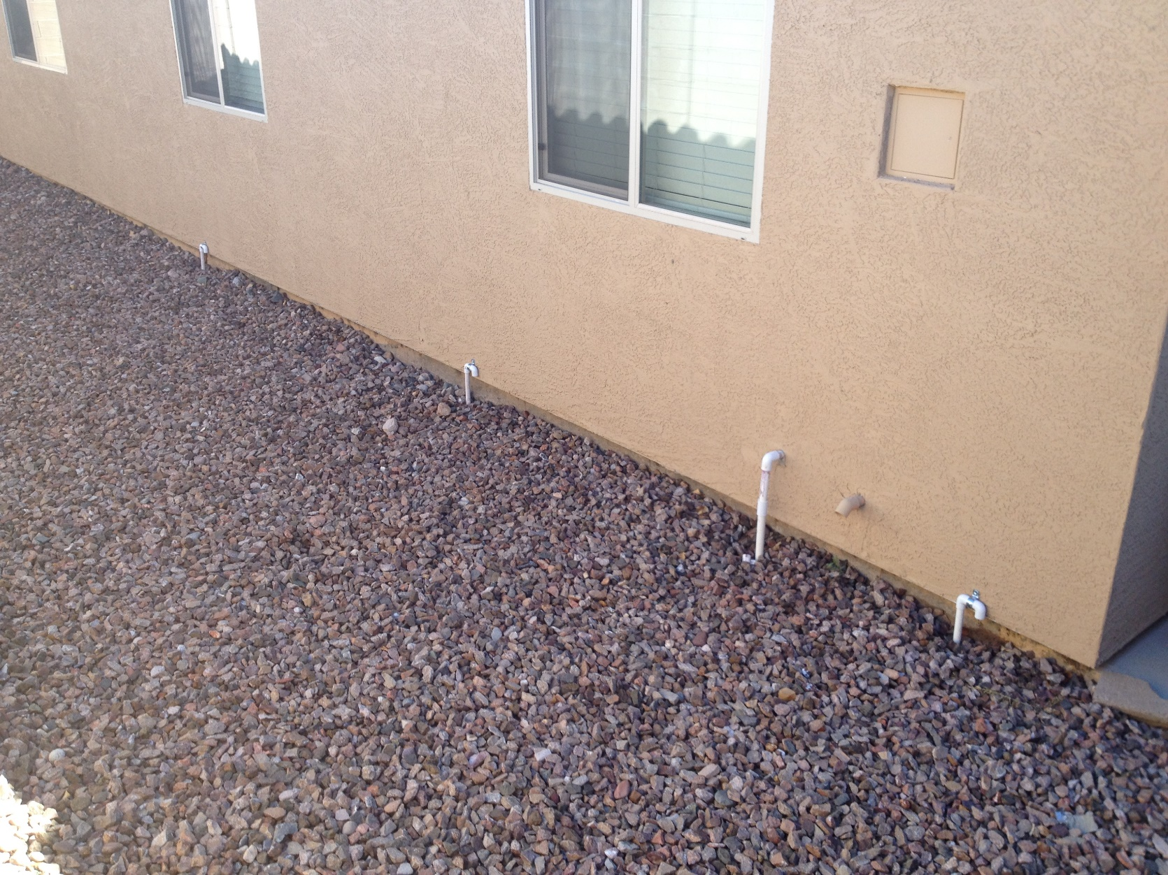
Moisture Level System Outside Air Inlets

Slide 10
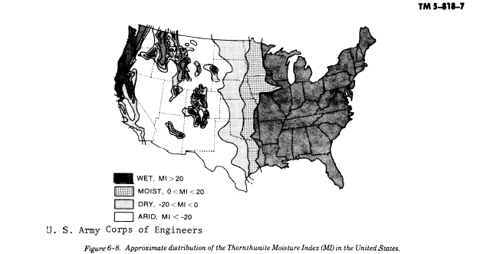
Arid Climate Regions

Slide 11
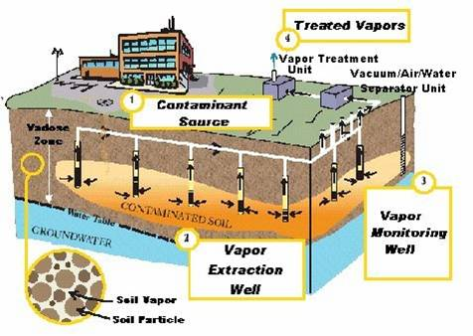
Deatherage experience with VES induced settlements in clay soils

Slide 12
Deatherage 1990 Paper on Soil Venting Ground Settlements

Slide 13
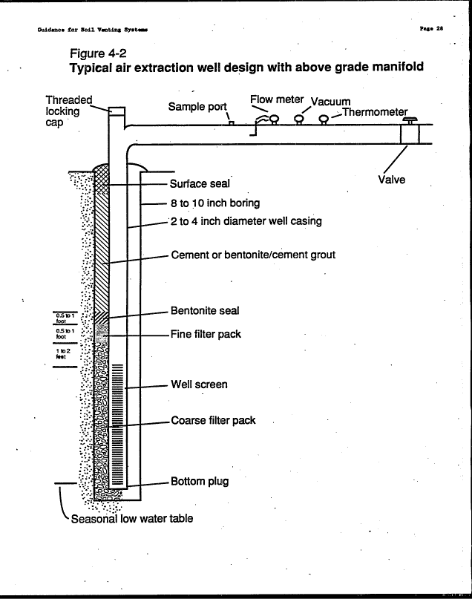
Guidance for Design, Installation and Operation of Soil Venting Systems – EPA - 1993

Slide 14
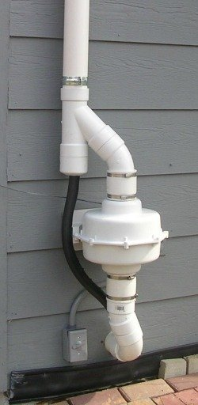
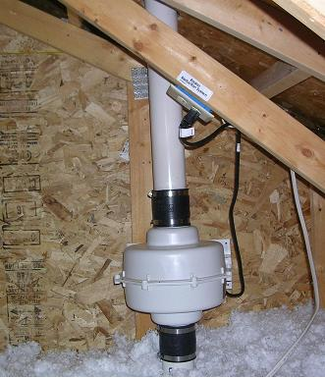
Radon Mitigation Systems – Note Condensate Trap

Slide 15
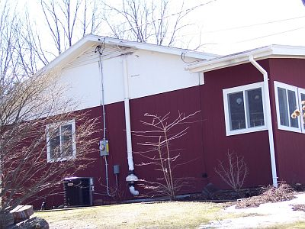
Black mildew is growing on the wall above the vent pipe outlet due to the moist air blown on it from the outlet pipe. The air pulled from under the basement floor by the radon fan can have high amounts of moisture (up to several gallons a day).

Slide 16
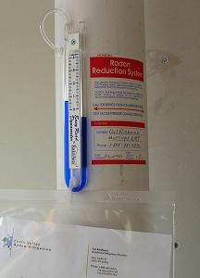
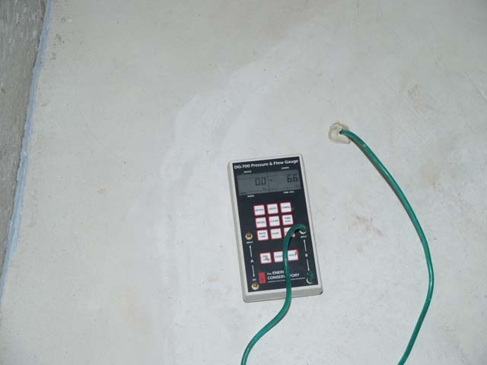
Water Manometer and Digital Micro-Monometer used to Confirm Extent of Suction Under Slab

Slide 17
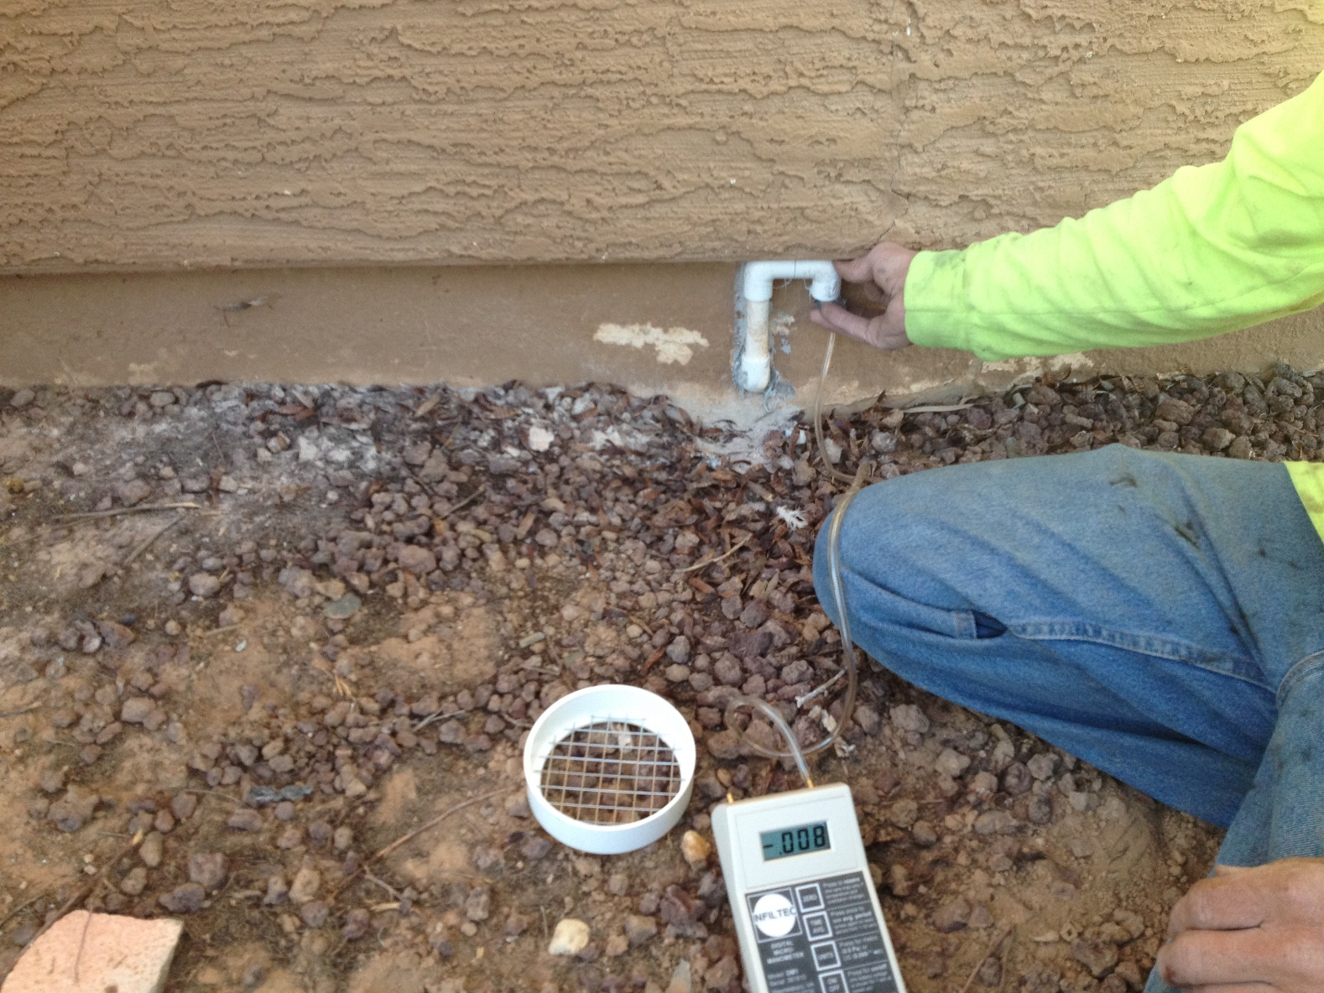
Measurement of Suction at Outside Air Inlet with Digital Micro-Manometer

Slide 18

Digital Anemometer - air velocity (ft/sec) times discharge pipe area (square ft) = discharge rate (cf/sec)

Slide 19
The discharge rate of the moist air from under slab, the temperature and the relative humidity of the exhaust air and the ambient air can be compared to calculate the pounds of water removed by the system.

Slide 20
One cubic foot of dry air at STP (60 degrees F and 1 ATM) weighs approximately 0.081 pounds
12.4 cubic feet of dry air at STP weighs 1.0 pound
12.9 cubic feet of dry air in Phoenix (60 degrees) weighs 1.0 pound
15.2 cubic feet of dry air in Flagstaff (60 degrees) weighs 1.0 pound

Slide 21
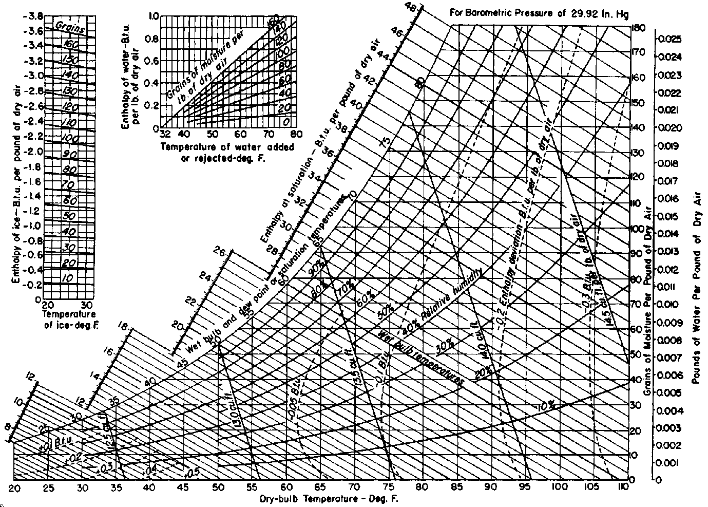
Psychrometric Chart

Slide 22
Psychrometric Chart

Slide 23
Psychrometric Chart

Slide 24
From the psychrometric chart, if the exhaust air temperature is 75 degrees F and the relative humidity of the exhaust air is 45 percent, there is 0.0086 pounds of water per pound of air exhausted. In the general Phoenix area, one pound of dry air takes up 12.9 cubic feet. If the Moisture Level System exhaust rate is 0.5 cfs, there is 0.5/12.9 = 0.039 pounds of air per second exhausted. 0.039 x 0.0086 = 0.0003354 pounds of water per second, or 0.020 pounds of water per minute, or 1.2 pounds of water per hour, or 29.0 pounds of water per day.

Slide 25
From the psychrometric chart, if the ambient outside air temperature is 75 degrees F and the relative humidity of the outside air is 25 percent, there is 0.005 pounds of water per pound of outside air. In the general Phoenix area, one pound of dry air takes up 12.9 cubic feet. If the replacement air inflow rate is 0.5 cfs, there is 0.5/12.9 = 0.039 pounds of air per second flowing under the slab. 0.039 x 0.005 = 0.000195 pounds of water per second, or 0.012 pounds of water per minute, or 0.7 pounds of water per hour, or 16.8 pounds of water per day returning back to the clay. The difference between 29.0 – 16.8 = 12.2 pounds of water removed per day.

Slide 26
AZ FN Solutions Monitoring Results
Customer Name | Date of Sample | City | MLM Run Time (estimated) months | Elevation Variance (Before) inch | Elevation Variance (After) inch | Net Heave Change (inch) | Estimated Exhaust Velocity (ft per sec) | Estimated Outlet Flow (cf/day) | Outlet Flow Air (pounds per day) | Temp. (Outside) F | RH % (Outside) | Pounds of water per pound of outside dry Air | Temp. (Outlet) F | RH % (Outlet) | Pounds of water per pound of outlet dry Air | Net pounds of water removed per day | Soil 12" under slab
DW | 11/27/2015 | Phoenix |  |  |  |  | 1.6 | 12096 | 930 | 72.9 | 87 | 0.015 | 81.9 | 87.6 | 0.021 | 5.6 | SC
YS | 12/24/2015 | Scottsdale |  |  |  |  | 5.9 | 44604 | 3431 | 68 | 54 | 0.0085 | 74.5 | 50.6 | 0.0095 | 3.4
HH | 01//16/2016 | Chandler |  |  |  |  | 1.3 | 9828 | 756 | 61.9 | 28.1 | 0.003 | 79.2 | 49.7 | 0.011 | 6.0
DW | 10/15/2016 | Peoria |  |  |  |  | 2.6 | 19656 | 1512 | 61.6 | 31.4 | 0.004 | 68.5 | 36.8 | 0.006 | 3.0
LA | 1/15/2016 | Scottsdale |  |  |  |  | 1.6 | 12096 | 930 | 56.5 | 42.1 | 0.0045 | 64.2 | 52.8 | 0.007 | 2.3 | CL-ML
TL | 1/15/2016 | Gilbert |  |  |  |  | 5.9 | 44604 | 3431 | 66.7 | 23.9 | 0.003 | 67.9 | 37.8 | 0.006 | 10.3
AM | 1/19/2016 | Phoenix |  |  |  |  | 2.0 | 15120 | 1163 | 46.9 | 59.2 | 0.004 | 69.4 | 99.9 | 0.016 | 14.0
JM | 1/22/2016 | Peoria |  |  |  |  | 1.6 | 12096 | 930 | 69.3 | 13 | 0.002 | 74.4 | 64 | 0.0125 | 9.8
AJ | 3/9/2016 | Gilbert | 19 | 1.2 | 1 | 0.2 (lowered) | 19 | 143640 | 11049 | 66.7 | 20.3 | 0.003 | 72 | 31 | 0.005 | 22.1
GS | 3/8/2016 | Surprise |  |  |  |  | 1.6 | 12096 | 930 | 76 | 21 | 0.004 | 75.2 | 33.3 | 0.006 | 1.9
DA | 2/29/2016 | Surprise |  |  |  |  | 0.33 | 2495 | 192 | 86.2 | 9 | 0.0025 | 101.5 | 18.5 | 0.007 | 0.9 | SC
RH | 2/26/2016 | Gilbert | 12 | 1 | 0.8 | -0.1 (Increase) | 33 | 249480 | 19191 | 77.5 | 17.3 | 0.0035 | 76.1 | 43 | 0.009 | 105.5
BB | 4/5/2016 | Mesa |  |  |  |  | 23 | 173880 | 13375 | 93.8 | 5.7 | 0.002 | 82.1 | 40.5 | 0.009 | 93.6
TA | 4/25/2016 | Gilbert | 17 | 1.3 | 1.3 | 0.2 (Lowered) | 7.9 | 59724 | 4594 | 78.8 | 6.6 | 0.001 | 80.2 | 32.8 | 0.008 | 32.2 | SM
GR | 4/26/2016 | Gilbert | 9 | 2.1 | 1.5 | 0.1 (Lowered) | 13 | 98280 | 7560 | 71.2 | 14.4 | 0.002 | 85.5 | 33.4 | 0.009 | 52.9 | ML
CR | 4/27/2016 | Litchfield | 11 | 2 | 1.9 | 0.1 (Lowered) | 0.33 | 2495 | 192 | 85 | 12.3 | 0.003 | 97 | 10.7/12.2 | 0.0045 | 0.3 | SM
RO | 4/29/2016 | Chandler | 12 | 1 | 0.6 | 0.2 (Lowered) | 0.33 | 2495 | 192 | 93.1 | 13.9 | 0.005 | 94.9 | 29.3 | 0.01 | 1.0 | SC-SM
WB | 5/3/2016 | Buckeye | 12 | 1.5 | 1.6 | 0 | 1.6 | 12096 | 930 | 93.1 | 9.6 | 0.003 | 90.7 | 22.7/15.7 | 0.005 | 1.9 | SC
RC | 5/5/2016 | Mesa | 11 | 2 | 2.1 | 0.2 (Lowered) | 0.33 | 2495 | 192 | 93.4/94.8 | 11.4/8.1 | 0.003 | 95.1/103.8 | 13.4/26.2 | 0.005 | 0.4
BT | 5/6/2016 | Wittmann | 11 | 2.9 | 3.3 | 0.5 (Lowered) | 2.6 | 19656 | 1512 | 70.2 | 35.2 | 0.006 | 73 | 41.2 | 0.0075 | 2.3
DR | 5/6/2016 | Phoenix | 19 | 1.2 | 1.2 | 0 | 2.3 | 17388 | 1338 | na | na | na | 58.3 | 25.2 | 0.003 | na
JD | 5/9/2016 | Phoenix | 11 | 2.5 | 2.4 | 0 | na | na | na | 99.3 | 29.7 | 0.0125 | 100.5 | 37.3 | 0.015 | na
JS | 5/9/2016 | Mesa | 13 | 3.2 | 3.5 | -0.2 (Increase) | 0.5 | 3780 | 291 | 92.3 | 13.3 | 0.0045 | 94.8 | 28.3 | 0.01 | 1.6
SB | 5/10/2016 | Gilbert | 18 | 2 | 2.3 | -0.1 (Increase) | 2.3 | 17388 | 1338 | 80.3 | 18.3 | 0.004 | 92.8 | 36.9 | 0.012 | 10.7
JT | 5/12/2016 | Chandler | 12 | 2 | 1.8 | 0 | na | na | na | 100.5 | 4.0 | 0.002 | 106 | 5.6 | 0.002 | na
CC | 5/13/2016 | Gilbert | 26 | 2.2 | 2.3 | 0 | 19 | 143640 | 11049 | 96.7 | 7.7 | 0.003 | 89.9 | 28.3 | 0.0085 | 60.8
DA | 5/18/2016 | Mesa | 8 | 1.1 | 1.1 | 0.2 (Lowered) | 0.7 | 5292 | 407 | 81.3 | 34.8 | 0.008 | 82.8 | 46.8 | 0.0115 | 1.4 | CL
HC | 5/19/2016 | Surprize | 9 | 1.2 | 1.2 | 0 | 0.33 | 2495 | 192 | 88.7 | 14.8 | 0.0045 | 93.7 | 13.8 | 0.005 | 0.1
DG | 5/20/2016 | Gilbert | 10 | 1.5 | 1.6 | 0 | 1 | 7560 | 582 | 91.2 | 18.4 | 0.0055 | 98.8 | 38 | 0.015 | 5.5

Slide 27
If a six inch thick clay layer under a 2000 square foot home has a starting moisture content of 25 percent and a dry density of 105 pcf, there is 105,000 pounds of dry soil and 26,250 pounds of water in the clay layer. At a removal rate of 100 pounds of water per day, it would take 131 days to remove ½ of the soil moisture from the clay layer.

Slide 28
When should we consider using the Moisture Level System under residential/commercial slabs?

Slide 29
Consider using the Moisture Level System when there is a near surface strata of originally dry expansive clay soil that has become wetted and is heaving under a portion of the floor slab of the structure. The source of the moisture must be identified and eliminated as part of this mitigation. There must be an air permeable layer of aggregate base or gravel between the floor slab and the expansive subgrade soils. Monitor the slab movements with repeated manometer surveys as the Moisture Level System dries the expansive clay soils. Monitor the exhaust air flow rate, temperature and relative humidity. Adjust the area of air removal if necessary to control areas of the slab that are still heaving or areas that start settling more than desired.
Suggested geotechnical testing to assess how much the heaved expansive clays can settle when dried include the following:

Slide 30
Example Response to Wetting Test

Slide 31
Example Response to Wetting Test

Slide 32
Example Response to Wetting Test

Slide 33
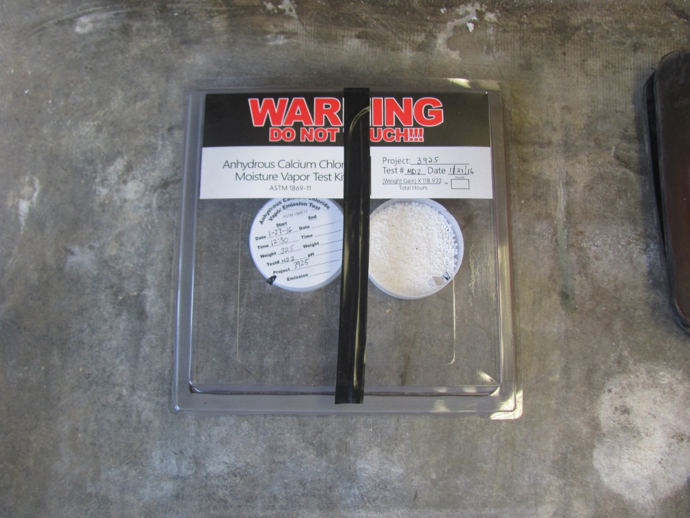
Moisture Vapor Transmission Problems – The Moisture Level System is a new important possible mitigation tool

